Slide 1
Design & Analysis of Algorithms

Slide 2
Radix Sort

Slide 3
Comparison / Non Comparison sorts
A comparison sort examines the data only by comparing two elements with a comparison operator.
For example:
Bubble sort --O(n²)
Selection sort --O(n²⁾
Insertion Sort--O(n²)
Merge Sort --O(n log n)
Some examples of sorts which are not comparison sorts :
Bucket sort etc.
Radix sort,
Counting sort,

Slide 4
Stable sort
stable sort: A sort that preserves the input order among equal elements.
A:
4
1
3
4
3
B:
1
3
3
4
4

Slide 5
Radix Sort
Input elements: d-digit numbers, each digit takes k possible values.
More generally: d-vectors, where i-th component takes ki values.
Key Idea: Sort digit by digit, from least to most significant digit,

Slide 6
Radix Sort :The basic Idea
Used (for example) to sort integers in the range 0 to 10000..
Digit-by-digit sort.
Sort on least-significant digit first with auxiliary stable sort.

Slide 7
Introduction
Radix sort is a small method that many people intuitively use when alphabetizing a large list of names. (Here Radix is 26, 26 letters of alphabet).
Radix sort do counter-intuitively by sorting on the least significant digits first. On the first pass entire numbers sort on the least significant digit and combine in a array. Then on the second pass, the entire numbers are sorted again on the second least-significant digits and combine in a array and so on.

Slide 8
Introduction
Radix sort is one of the best general sorting techniques known. It is quite simple to understand, but more difficult than most algorithms to implement.
Radix sorting is a technique for ordering a list of positive integer values. The values are successively ordered on digit positions, from right to left. This is accomplished by copying the values into buckets, where the index for the bucket is given by the position of the digit being sorted. Once all digit positions are examined, the list must be sorted.

Slide 9
Radix Sort
Considers keys as numbers
A d-digit number will occupy a field of d columns
Sorting looks at one column at a time
For a d digit number, sort the least significant digit first
Continue sorting on the next least significant digit, until all digits have been sorted
Requires only d passes through the list

Slide 10
RADIX-SORT Algorihm
Key idea: sort the least significant digit first
RadixSort(A, d)
for i=1 to d
StableSort(A) on digit i
Notes:
d is total number of digits in any number

Slide 11
RADIX-SORT
Alg.: RADIX-SORT(A, d)
for i ← 1 to d
do use a stable sort to sort array A on digit i
1 is the lowest order digit, d is the highest-order digit

Slide 12
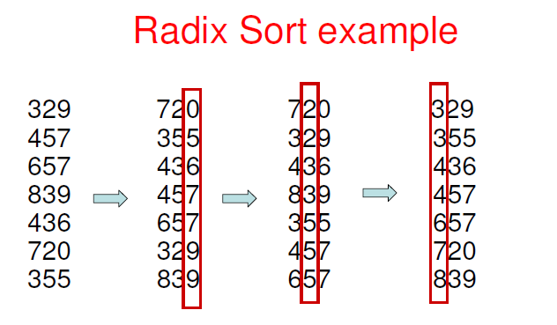
Radix Sort Example

Slide 13
Analysis of Radix Sort
Given n numbers of d digits each, where each digit may take up to k possible values, RADIX-SORT correctly sorts the numbers in Θ(d(n+k))
One pass of sorting per digit takes Θ(n+k) assuming that we use counting sort
There are d passes (for each digit)
Notes:
N is the number of digits and d is the length of the digit

Slide 14
Correctness of radix sort
Induction on digit position
Assume that the numbers are sorted by their low-order t – 1 digits.
7 2 0
3 2 9
3 2 9
3 5 5
4 3 6
4 3 6
8 3 9
4 5 7
Two numbers that differ in digit t are correctly sorted.
Sort on digit t
3 5 5
6 5 7
4 5 7
7 2 0
6 5 7
8 3 9

Slide 15
Correctness of radix sort
Induction on digit position
Assume that the numbers are sorted by their low-order t – 1 digits.
7 2 0
3 2 9
3 2 9
3 5 5
4 3 6
4 3 6
8 3 9
4 5 7
Sort on digit t
Two numbers that differ in digit t are correctly sorted.
3 5 5
6 5 7
4 5 7
7 2 0
Two numbers equal in digit t are put in the same order as the input ⇒ correct order.
6 5 7
8 3 9

Slide 16
Example- Radix Sort
Consider the following 9 numbers:
493 812 715 710 195 437 582 340 385
Use Radix Sort to sort the given data

Slide 17
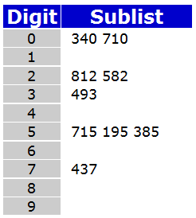
Example- Radix Sort
We should start sorting by comparing and ordering the one's digits
340 710 812 582 493 715 195 385 437

Slide 18
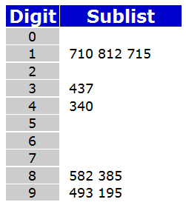
Example- Radix Sort
340 710 812 582 493 715 195 385 437
Now, the sublists are created again, this time based on the ten's digit:
710 812 715 437 340 582 385 493 195

Slide 19
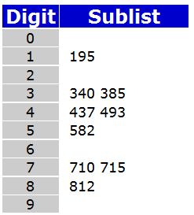
Example- Radix Sort
710 812 715 437 340 582 385 493 195
Finally, the sublists are created according to the hundred's digit:
195 340 385 437 493 582 710 715 812

Slide 20
Analysis of Bucket Sort
Class : Sorting algorithm
Data structure: Array
Worst case performance : O(Kn)
Worst case space complexity: O(n *k)

Slide 21
Example for Test
Apply the Radix sort on the following data
170, 45, 75, 90, 802, 24, 2, 66

Slide 22
Conclusion
In practice, radix sort is fast for large inputs, as well as simple to code and maintain.
Example (32-bit numbers):
At most 3 passes when sorting >= 2000 numbers.
Merge sort and quick sort do at least ( lg 2000 )= 11 passes.

